Slide 1



Photo Gallery Management System
Soham Joshi L013 Anuj Iyer L011
Gautami Ankam L001 Siya Jain L012

Slide 2

Topics Covered
Topic 1: Introduction & Problem Statement
Agenda
Topic 2: Data Structures used
Topic 3: Algorithms used
Topic 4: Code and Outputs

Slide 3
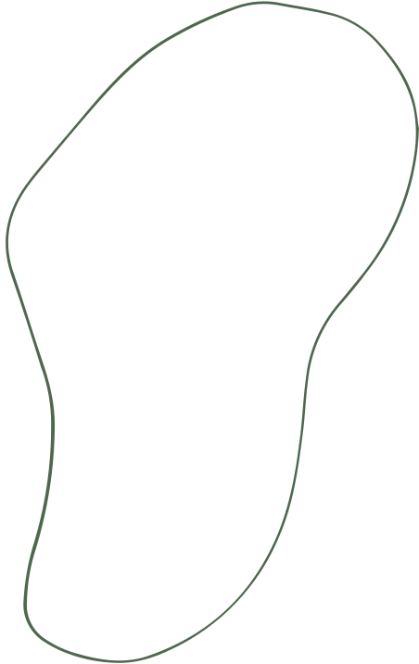

Problem Statment :
To create an efficient and menu-based Photo Gallery System that incorporates various data structures and algorithms in order to improve and optimize efficiency.

Slide 4
Architecture
The Photo Gallery System is designed with a multi-data structure system in mind, using C++ for core system efficiency. The system includes:
Core System (C++): Manages photo storage, metadata indexing, sorting, and recent photo tracking using optimized data structures like vectors, hash maps, and priority queues.
Database (SQLite): Used for storage of photos and tag information. Can be updated and retrieved easily.

Slide 5
Algorithms Used
QuickSort Algorithm:
Purpose: To sort arrays of photos by different criteria (date, size, view count).
Steps:
Choose a pivot element from the array.
Partition the array such that elements less than the pivot are on the left, and elements greater than the pivot are on the right.
Recursively apply the above steps to the sub-arrays formed by partitioning.
Time Complexity: O(nlogn) on average, O(n2) in the worst case.
Binary Search Algorithm:
Purpose: To search for a specific date in a sorted array of photos.
Steps:
Compare the target date with the middle element of the array.
If match, return date
If the target date is less than the middle element, repeat the search on the left sub-array. and vice versa.
Time Complexity: O(logn).
KMP (Knuth-Morris-Pratt) Algorithm:
Purpose: To search for a pattern within a larger text .
More efficient backtracking algorithm which uses Longest Prefix Array (LPS).
Steps:
Preprocess the pattern to create an LPS (Longest Prefix Suffix) array.
Use the LPS array to efficiently search for the pattern in the text.
Time Complexity: Time Complexity: O(n+m), n is the length of text,m is length of pattern.

Slide 6
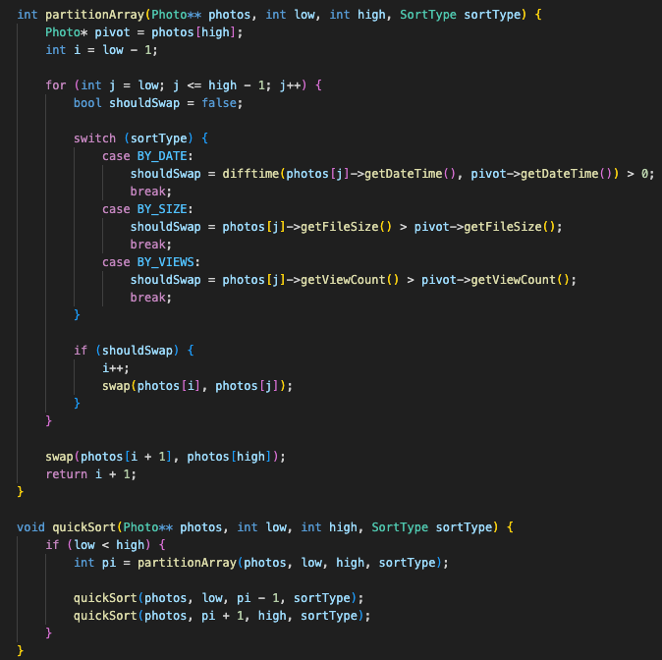
QuickSort Algorithm

Slide 7
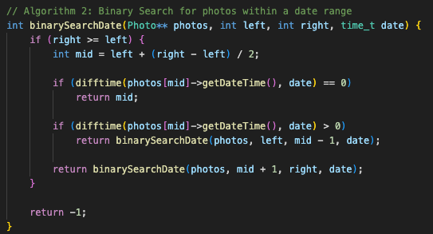
Binary Search Algorithm

Slide 8
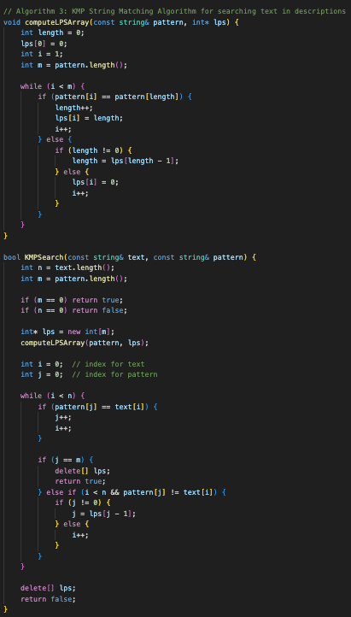
KMP (Knuth-Morris-Pratt) Algorithm

Slide 9
Data structures
AVL Tree:
Purpose: To maintain a balanced binary search tree for photos, allowing efficient insertion, deletion, and search operations.
Trie:
Purpose: To efficiently search for photos by tags using prefix matching.
Priority Queue (Max Heap):
Purpose: To efficiently retrieve the most recent or most popular photos.
Hash Map:
Purpose: To efficiently search for photos by location.
Linked List:
Purpose: To maintain a sequential list of photos for operations like appending and removing.

Slide 10
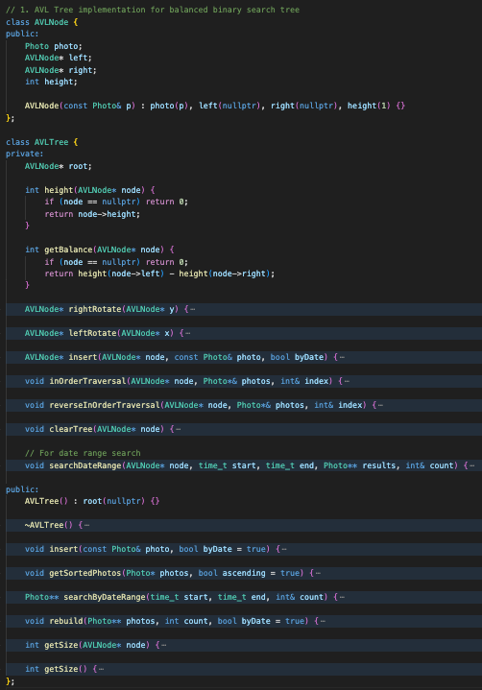
AVL Tree

Slide 11
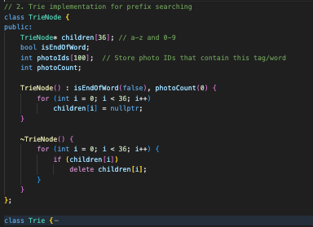
Trie

Slide 12
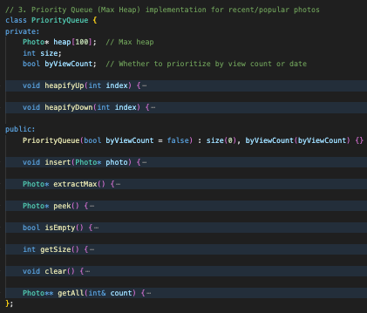
Priority Queue (Max Heap)

Slide 13
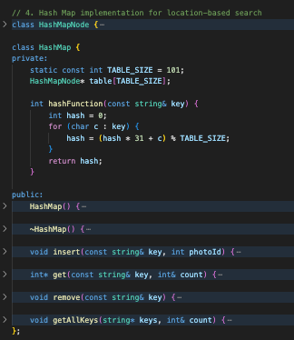
Hash Map

Slide 14
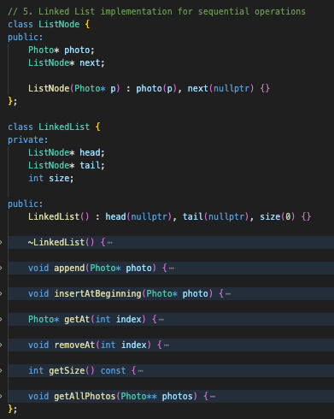
Linked List

Slide 15
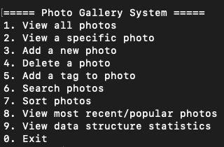
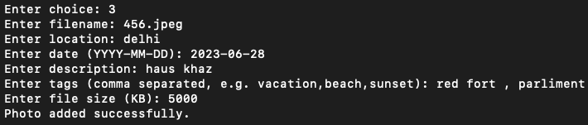
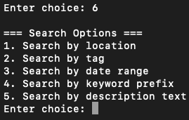



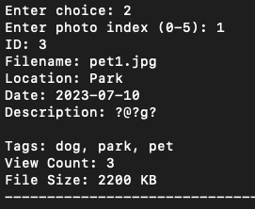
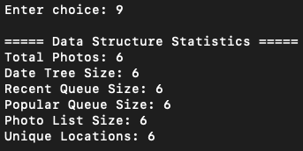
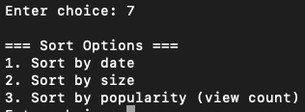

Output

Slide 16
Thank you!

